Slide 1
Daily maintenance
Technical - Overview
Integration Team
February 2018

Slide 2
AGENDA
Overview
End of day procedures
Start of day procedures
Tasks setup
System Configuration

Slide 3
“
GPP enables bank to perform various SOD, EOD, Upload and Maintenance tasks via SOA essential for proper operation of application”
Fndt Message Format – Technical Guide

Slide 4


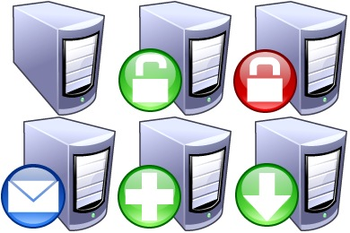
Maintenance overview
GPP
Processing Engine
Multi-office
Office local time
Run in parallel
Order is crucial
Note: Apply Change is always the last task.
UI
Maintenance Tasks
operator mode
Maintenance Tasks
SOA/Web Service
APPROVAL
SOD
EOD
UPLOAD
CLEANUP
unattended/automatic mode

Slide 5
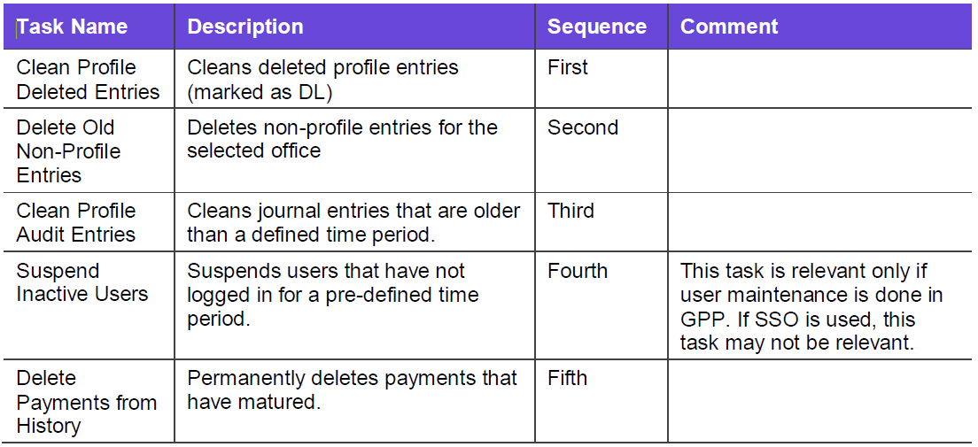
Eod - housekeeping

Slide 6
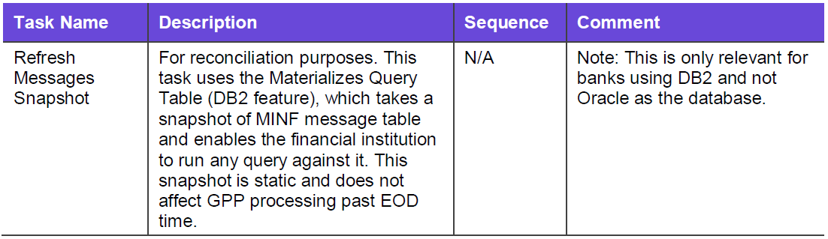
Eod - reconciliation

Slide 7
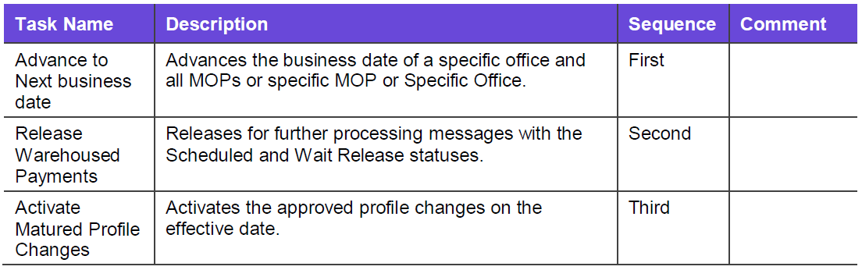
SOD - housekeeping

Slide 8

TASKS SERVICE
<FndtHeader>
<credentials> general identifying attributes
<UserID> UserID for authorization
<Role> Role for supplied User
<RunTaskRequest> Task Service Request
<header>
<UserID> User for creating audit record
<taskID> ID of tasks to be executed
<record> Relevant required fields for completing action
<field> Field for given Task

Slide 9
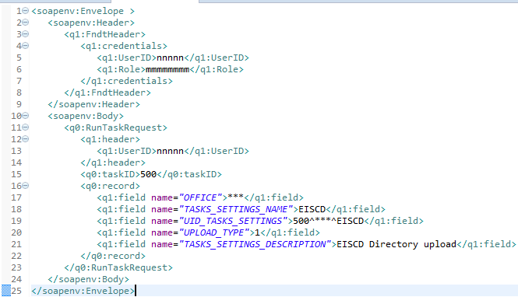
TASKS SERVICE- example
User Details
Task to be executed
Supporting information

Slide 10
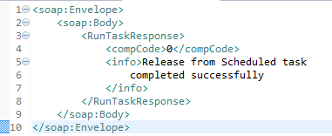
Tasks service response - Success
<RunTaskResponse> Task execution response
<compCode> Response code success/failure
<info> Additional information

Slide 11
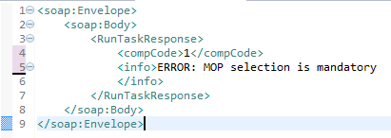
Tasks service response - failure
<RunTaskResponse> Task execution response
<compCode> Response code success/failure
<info> Additional information

Slide 12
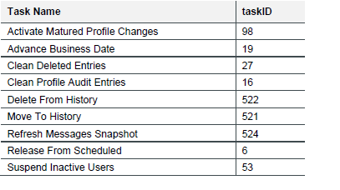
Task monitoring
Using the response from Web service task
Note : If the upload related task needs to be changed to run in asynchronize mode, it is not in the product scope and needs to be customized accordingly.
Monitoring the Activity Audit database table
id | description
77791 | Start of task scheduler
77792 | End of task scheduler - Success
77793 | Start execution of task
77794 | End execution of task - execution status
77795 | End of task scheduler - Failure

Slide 13
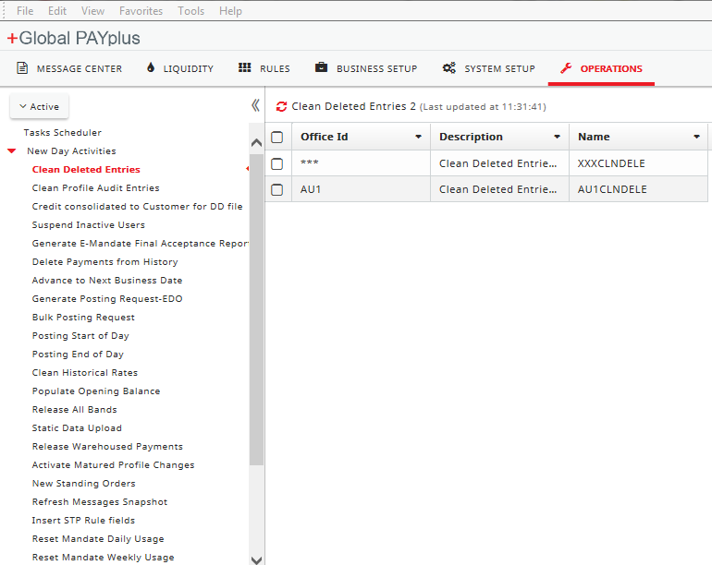
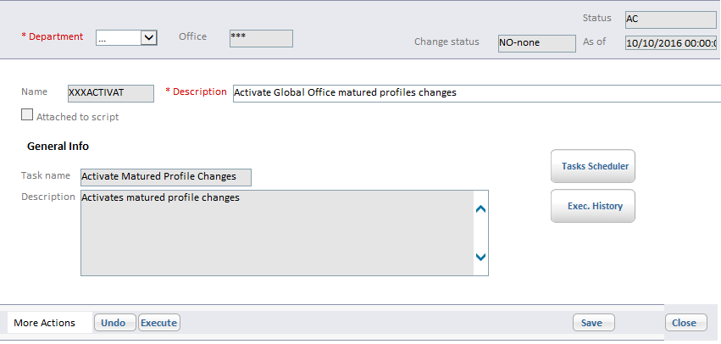
Tasks UI
GPP SP has defined a number of SOD, EOD tasks. These tasks can be executed in three manners.
By invoking Task Service, Via GPP UI, By Scheduling the tasks

Slide 14
Thank you
Arnab Podder
Integration Team
Arnab.podder@finastra.com

